Slide 1


Flutter
Build apps for any screen
From: Jonas Lieske, Daniel Worbis & Manuel osterloh
Module: ESD – Enterprise system development

Slide 2

AGENDA
1. Intro to Flutter and Dart
2. Flutter Basics
3. Advanced Techniques
4. Setup
5. Interactive Session
6. Q&A
7. Conclusion
tinyurl.com/esdflutter

Slide 3
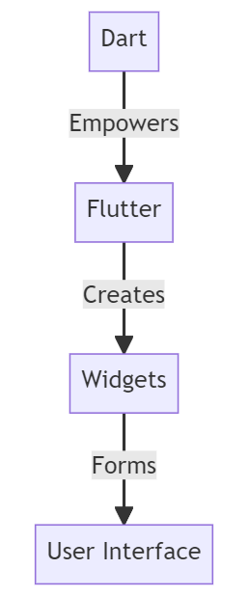
INTRO TO FLUTTER AND DART
What is Flutter and Dart?
Flutter: Google’s UI toolkit for natively compiled apps
Mobile, Web & Desktop in a single codebase
It offers
Cross platform development
Platform-specific code
Hot reload
Widgets
Coded in Dart
Java + React Syntax
OOP
JIT- & AOT-compilation

Slide 4
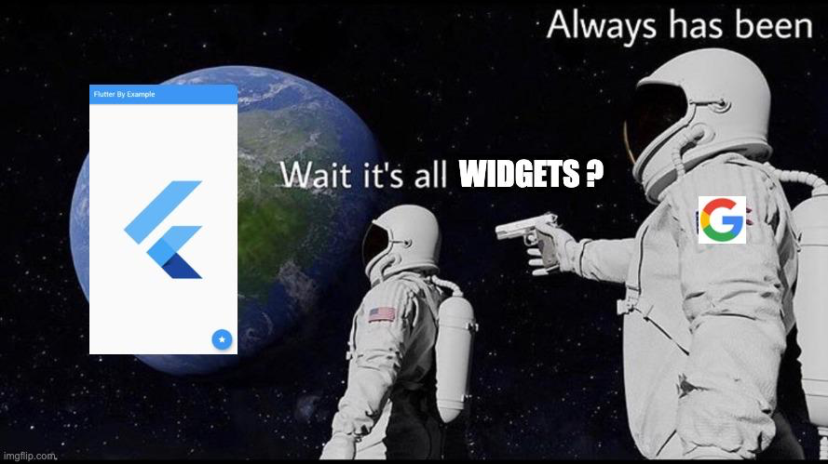
INTRO TO FLUTTER AND DART
What is Flutter and Dart?
Flutter: Google’s UI toolkit for natively compiled apps
Mobile, Web & Desktop in a single codebase
It offers
Hot reload
Widgets
Platform-specific code
Coded in Dart
Java + React Syntax
OOP
JIT- & AOT-compilation

Slide 5

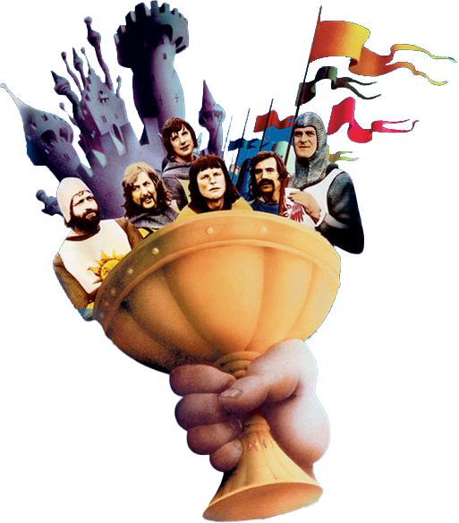
INTRO TO FLUTTER AND DART
Why Flutter is NOT the Holy Grail
Bloated Codebase
Mobile != Web
iOS & Android ~95% the same
Web (desktop) has many different approaches
1.2 – 1.5 * X still better than 3X
Easy scaling and MVP → Native
Flutter Web founders praise its app-centric services
No hot reload for Flutter Web
Chrome, Safari, Edge, Firefox support
NO SEO!
Notes:
Push Notifications
Offline Access and Caching
Background Sync
Geolocation Services
Camera and Microphone Access
Motion Sensors and Gyroscope
Speech Recognition
Touch Gestures
Payment Gateways
Accelerated Mobile Pages (AMP)
Progressive Web App (PWA) Features Flutter web prioritises performance, fidelity, and consistency. This means application output does not align with what search engines need to properly index. For web content that is static or document-like, we recommend using HTML—just like we do on flutter.dev, dart.dev, and pub.dev. You should also consider separating your primary application experience — created in Flutter — from your landing page, marketing content, and help content — created using search-engine optimised HTML.

Slide 6
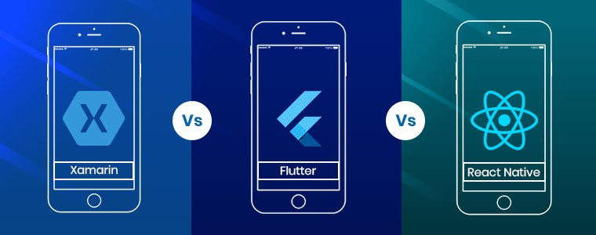
INTRO TO FLUTTER AND DART
Xamarin vs. Flutter vs. React Native

Slide 7


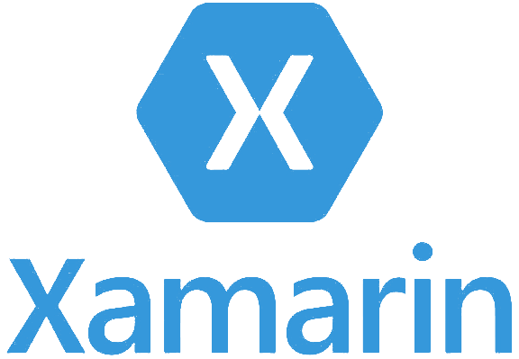




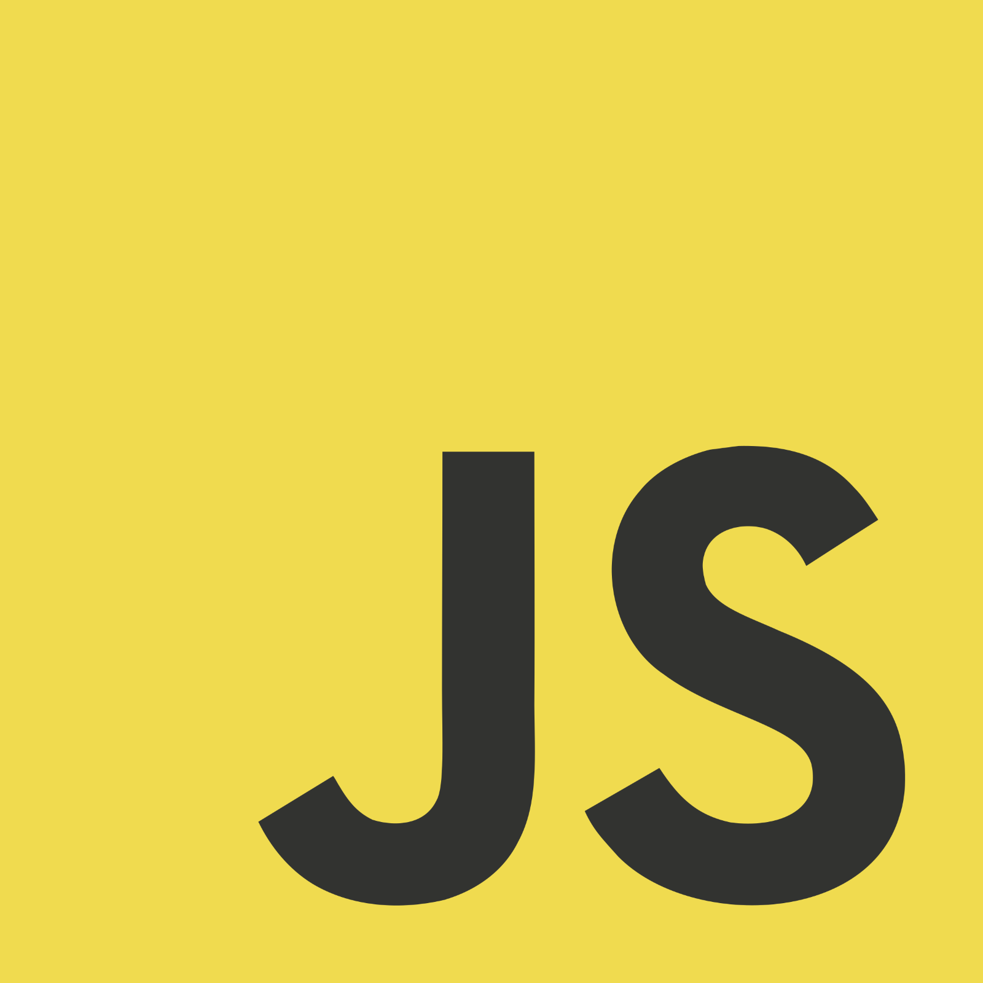


INTRO TO FLUTTER AND DART
 | Flutter
Developed by
Programming Language
Performance | High (native ARM code) | Close to native | Native API leveraging
UI Design | - Material Design - Cupertino - Highly customizable | - Native-like experience - platform-specific components | - Access to full range of native features - High-quality UI
Third-Party Libraries | Growing ecosystem (flutter pub) | Extensive ecosystem (npm) | Shared code libraries across platforms
Community and Support | - Strong and active community - Extensive comprehendible documentation | - Large, active community - comprehensive documentation | - Smaller community - Part of .NET platform
Disadvantages | - Requires learning Dart - limited native modules | - Performance issues in complex tasks - Limited older device support | - .NET familiarity needed - Dependency on Visual Studio
Xamarin vs. Flutter vs. React Native

Slide 8
INTRO TO FLUTTER AND DART
Dart Special Features
Dart is null-safe
int? nullableInt; // Nullable type
int nonNullableInt; // Non-Nullable type
nullableInt! // Explicit non-nullable
nullableInt ?? 0; // int or 0
nullableString?.toLowerCase(); // string or null
Separates nullable from non-nullable types
Compiler forces declaration of nullable types
Reduces run-time errors

Slide 9
INTRO TO FLUTTER AND DART
Dart Special Features
Dart has extensions
extension StringParsing on String {
bool containsUppercase(String input){
return input.contains(RegExp(r'[A-Z]'));
}
}
void main() {
String name = "Larry";
print(name.containsUppercase(name));
}
Allows adding new functionality to existing types without modifying the original class
Useful for enhancing types from libraries where you don’t have access to the source code

Slide 10
INTRO TO FLUTTER AND DART
Dart Special Features
Dart has a built-in builder pattern
var myButton = Button()
..color = Colors.blue
..text = "Click me"
..render();
Use the same instance by using ".."
No need to return instance on every function

Slide 11
INTRO TO FLUTTER AND DART
Dart Special Features
Dart has simple access modifiers
void _veryPrivateMethod() {
print(“Hello World”);
}
void veryPublicMethod() {
print(“Hello World”);
}
The default scope is public
Private scope is being defined with an "_" at the beginning of the name => Forcing naming standard
There are is no "protected" access scope

Slide 12
INTRO TO FLUTTER AND DART
Dart Special Features
Dart has named constructors
class Point {
double x, y;
// Normal constructor
Point(this.x, this.y);
// Named constructor
Point.origin()
: x = 0,
y = 0;
}
Point(10,20); // x=10, y=20
Point.origin(); // x=0, y=0
Less overloading of constructors
Makes it possible to have various initialization scenarios

Slide 13
INTRO TO FLUTTER AND DART
Dart Special Features
Dart has optional + named parameters
class Person {
String lastName;
String occupation;
Person(this.lastName,
{this.occupation = 'unknown'}
);
}
void main() {
Person person1 = Person("Doe", 18);
Person person2 = Person(
"Doe", 18, occupation: "Project Manager"
);
}
Named parameters can make code more readable
Both optional and named parameters can have default values, used when an argument isn't provided.

Slide 14

FLUTTER BASICS
What are Widgets?
Widget Types
Flutter Dev

Slide 15
FLUTTER BASICS
Layouts: Container, Row, Column, etc.
Single-child layout widgets
Multi-child layout widgets

Slide 16
FLUTTER BASICS
Layouts: Container, Row, Column, etc.
Container
Container(
height: 300,
width: 300,
color: Colors.blue
),

Slide 17
FLUTTER BASICS
Layouts: Container, Row, Column, etc.
Container
Container(
padding: EdgeInsets.all(10),
height: 200,
width: 200,
color: Colors.blue
),

Slide 18
FLUTTER BASICS
Layouts: Container, Row, Column, etc.
Container
Container(
margin: EdgeInsets.all(10),
height: 200,
width: 200,
color: Colors.blue
),

Slide 19
FLUTTER BASICS
Layouts: Container, Row, Column, etc.
Container
Hello World!
Container(
height: 200,
width: 200,
color: Colors.blue,
child:
const Text("Hello World!")
),

Slide 20
FLUTTER BASICS
Layouts: Container, Row, Column, etc.
Center
Center(
child: Container(
height: 200,
width: 200,
color: Colors.blue,
child:
const Center(
child: Text("...")
)))
Hello World!

Slide 21
FLUTTER BASICS
Layouts: Container, Row, Column, etc.
Align
Align(
alignment: Alignment.bottomLeft,
child: Container(
height: 200,
width: 200,
color: Colors.blue,
child:
const Center(
child: Text("...")
)))
Hello World!

Slide 22
FLUTTER BASICS
Layouts: Container, Row, Column, etc.
Expanded
Expanded(
child: Container(
color: Colors.blue,
child: const Center(
child:
Text("Hello World!")
)
))
Hello World!

Slide 23

FLUTTER BASICS
Layouts: Container, Row, Column, etc.
Expanded
Expanded(
child: Container(
color: Colors.blue,
child: const Center(
child:
Text("Hello World!")
)
))

Slide 24
FLUTTER BASICS
Layouts: Container, Row, Column, etc.
Expanded
Expanded(
child: Container(
color: Colors.blue,
child: const Center(
child:
Text("Hello World!")
)
))
The container doesn't know where to stop expanding.
Only use unconstrained sizes within:
LimitedBox
Row
Column

Slide 25
FLUTTER BASICS
Layouts: Container, Row, Column, etc.
LimitedBox
LimitedBox(
child: Container(
color: Colors.blue,
child: const Center(
child:
Text("Hello World!")
)
))
Hello World!

Slide 26
FLUTTER BASICS
Layouts: Container, Row, Column, etc.
Single-child layout widgets
Multi-child layout widgets

Slide 27
FLUTTER BASICS
Layouts: Container, Row, Column, etc.
Column
Column(
children: [
Container(...), // RED
Container(...), // GREEN
Container(...), // BLUE
]
)

Slide 28
FLUTTER BASICS
Layouts: Container, Row, Column, etc.
Column
Column(
children: [
Expanded(
child: Container(...) // RED
),
Container(...), // GREEN
Container(...), // BLUE
]
)

Slide 29
FLUTTER BASICS
Layouts: Container, Row, Column, etc.
Column
Column(
mainAxisAlignment:
MainAxisAlignment.center,
children: [
Container(...), // RED
Container(...), // GREEN
Container(...), // BLUE
])
Main Axis

Slide 30
FLUTTER BASICS
Layouts: Container, Row, Column, etc.
Column
Column(
mainAxisAlignment:
MainAxisAlignment.spaceBetween,
children: [
Container(...), // RED
Container(...), // GREEN
Container(...), // BLUE
])

Slide 31
FLUTTER BASICS
Layouts: Container, Row, Column, etc.
Row
Row(
mainAxisAlignment:
MainAxisAlignment.spaceBetween,
children: [
Container(...), // RED
Container(...), // GREEN
Container(...), // BLUE
])
Main Axis

Slide 32
FLUTTER BASICS
Layouts: Container, Row, Column, etc.
Stack
Stack(
children: [
Container(...), // H/W 100 RED
Container(...), // H/W 90 GREEN
Container(...), // H/W 80 BLUE
])

Slide 33
FLUTTER BASICS
Layouts: Container, Row, Column, etc.
ListView
ListView(
children: [
Container(...), // RED
Container(...), // GREEN
Container(...), // BLUE
… // More container
])

Slide 34
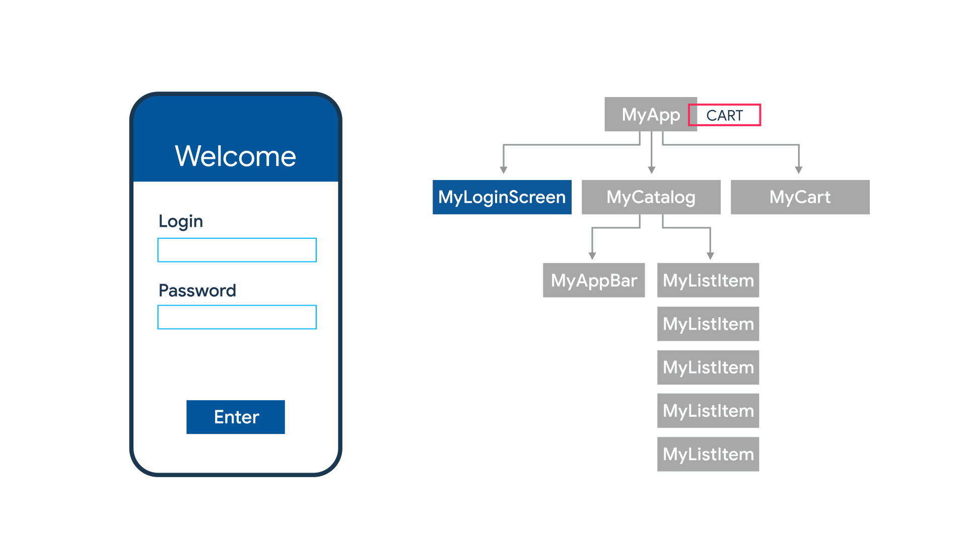
ADVANCED TECHNIQUES
State Management
Used to share applications states and data across an app
Many approaches (setState, Provider, InheritedWidget, Redux,...)
Depends on your use cases and taste
Flutter is declarative
Notes:
Flutter builds its user interface to reflect the current state of your app
In declarative programming, you describe what you want to achieve, and the underlying system takes care of how to implement it. You declare the desired state of the UI.
In imperative programming, you explicitly specify the steps needed to achieve a desired state. You tell the program how to do things.

Slide 35
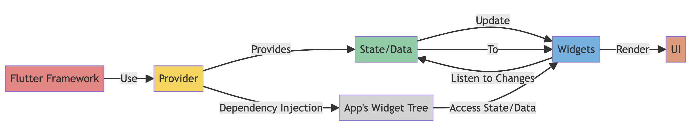
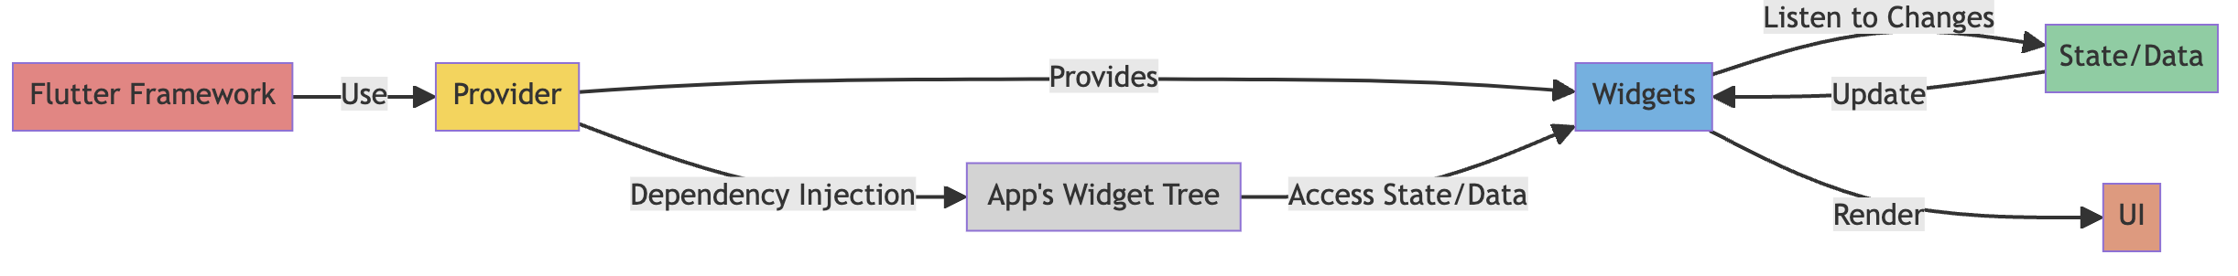
ADVANCED TECHNIQUES
State Management
Provider works similar to Observer Pattern
With ChangeNotifier and Listeners
On change, call notifyListeners() to trigger all builder methods of Consumer widgets

Slide 36
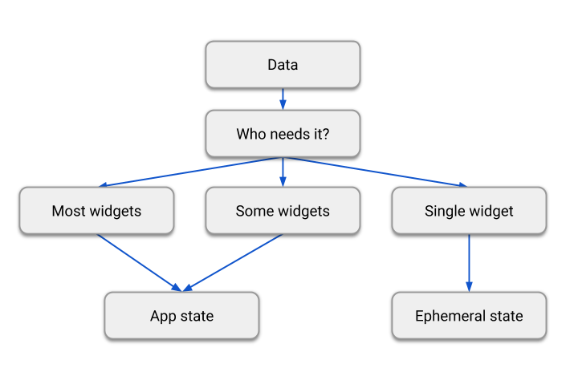
ADVANCED TECHNIQUES
State Management
Two types of state:
Ephemeral (local): No other part of your app needs to access the state value
App (global): State you want to share across many app parts, e.g. user preferences, login info, shopping cart,…
“The rule of thumb is: Do whatever is less awkward.”
- Author of Redux, Dan Abramov

Slide 37
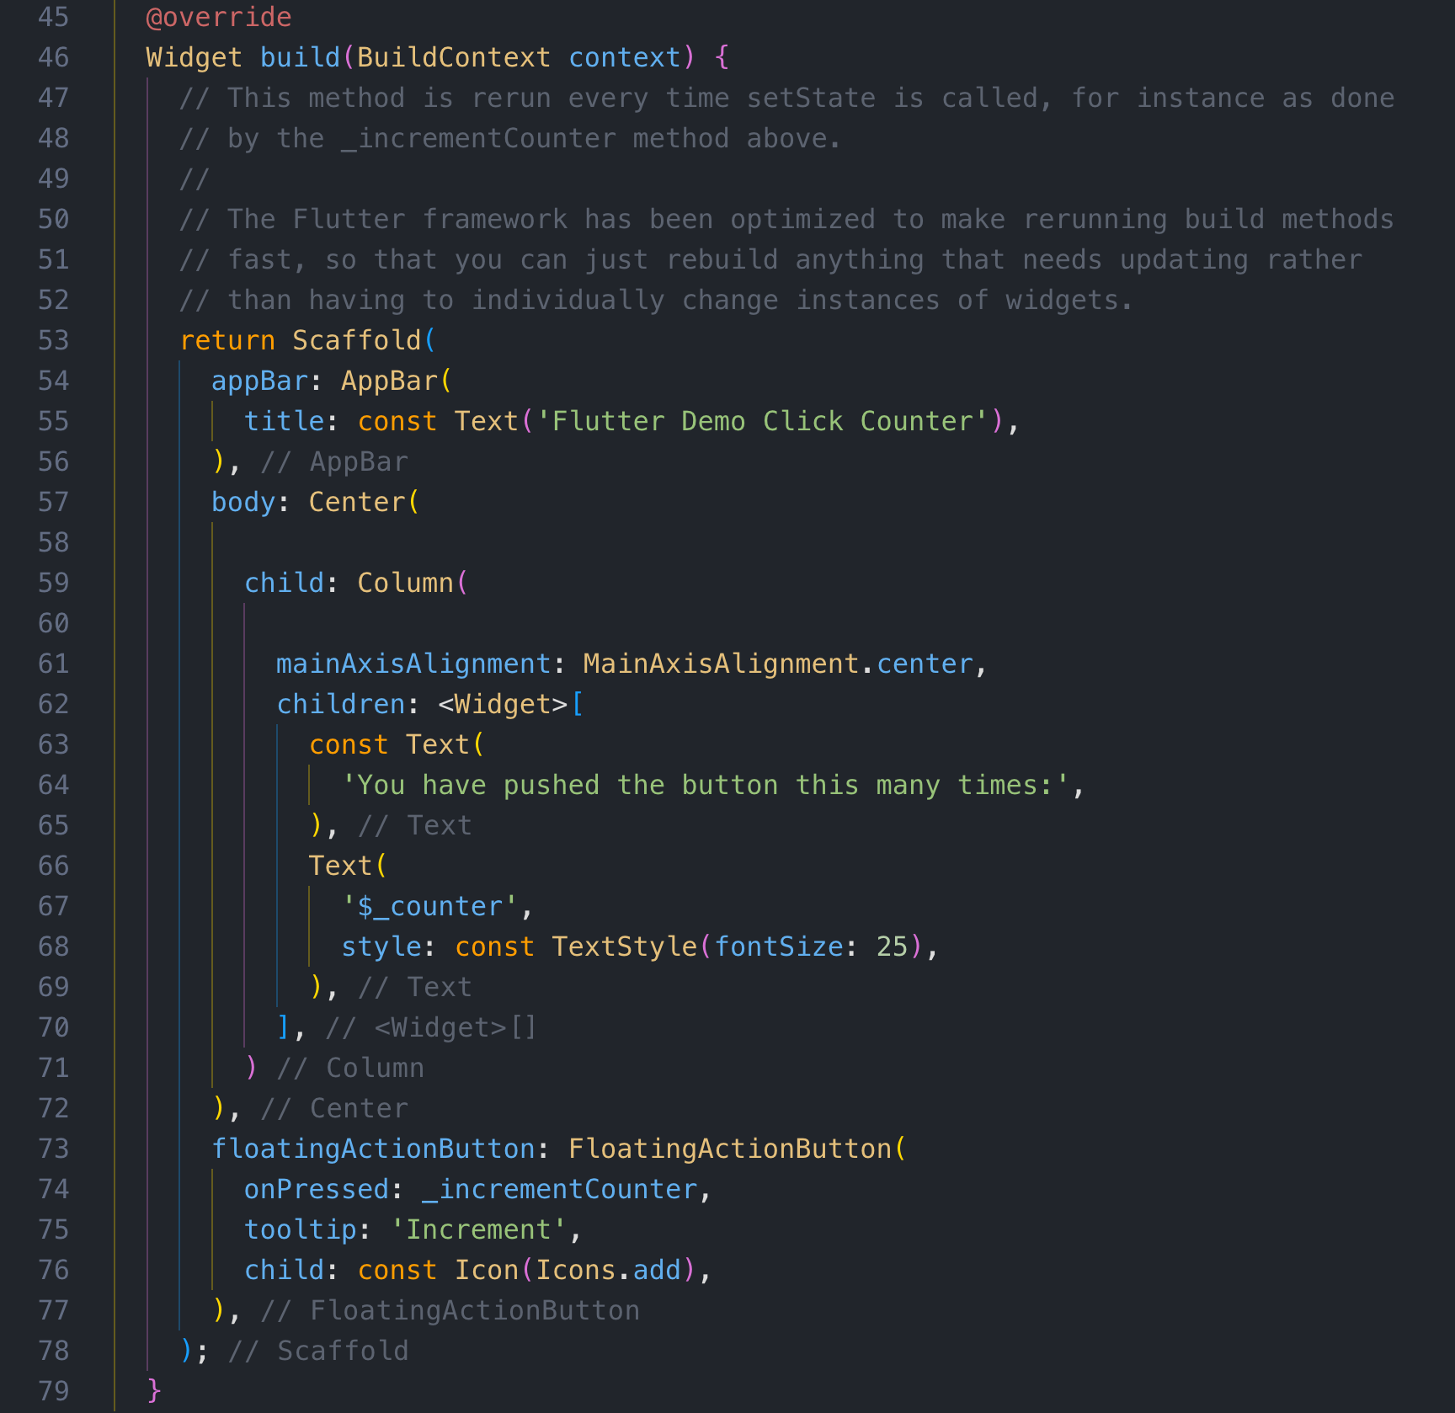
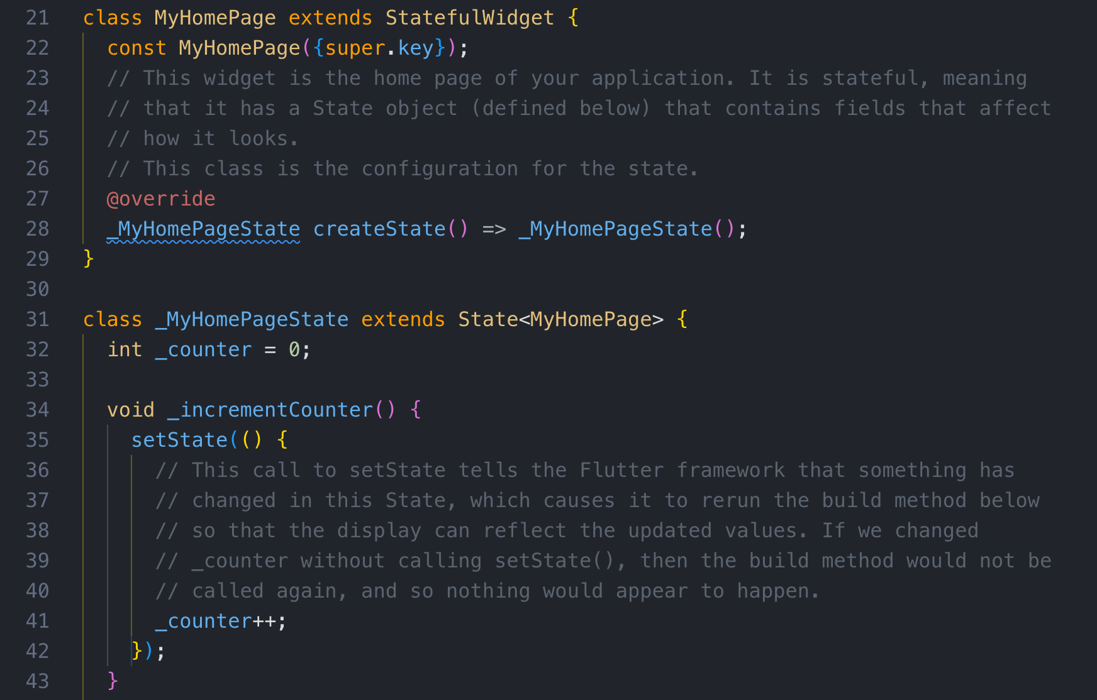
ADVANCED TECHNIQUES
State Management
“setState()” is the simplest form of state management in Flutter
It's built into the StatefulWidget.
Suitable for small apps or withing single widgets, or closely related group of widgets
Calling setState() notifies Flutter about a change
Flutter then schedules a rebuild

Slide 38
ADVANCED TECHNIQUES
State Management
“setState()” is the simplest form of state management in Flutter
It's built into the StatefulWidget.
Suitable for small apps or withing single widgets, or closely related group of widgets
Calling setState() notifies Flutter about a change
Flutter then schedules a rebuild

Slide 39
ADVANCED TECHNIQUES
Plugins, Packages…
Packages: https://pub.dev/
Adding a package dependency
flutter pub add css_colors
Removing a package dependency
flutter pub remove css_colors
Notes:
What is the difference between a package and a plugin? A plugin is a type of package—the full designation is plugin package, which is generally shortened to plugin.
Packages
At a minimum, a Dart package is a directory containing a pubspec.yaml file. Additionally, a package can contain dependencies (listed in the pubspec), Dart libraries, apps, resources, tests, images, fonts, and examples. The pub.dev site lists many packages—developed by Google engineers and generous members of the Flutter and Dart community— that you can use in your app.
Plugins
A plugin package is a special kind of package that makes platform functionality available to the app. Plugin packages can be written for Android (using Kotlin or Java), iOS (using Swift or Objective-C), web, macOS, Windows, Linux, or any combination thereof. For example, a plugin might provide Flutter apps with the ability to use a device’s camera.
https://docs.flutter.dev/packages-and-plugins/using-packages

Slide 40


SETUP
FlutLab.io
Why FlutLab.io?
No local setup, access anywhere
Great for beginners, lots of templates, no IDE setup
Usual IDEs:
Visual Studio Code
Android Studio
tinyurl.com/esdtask

Slide 41
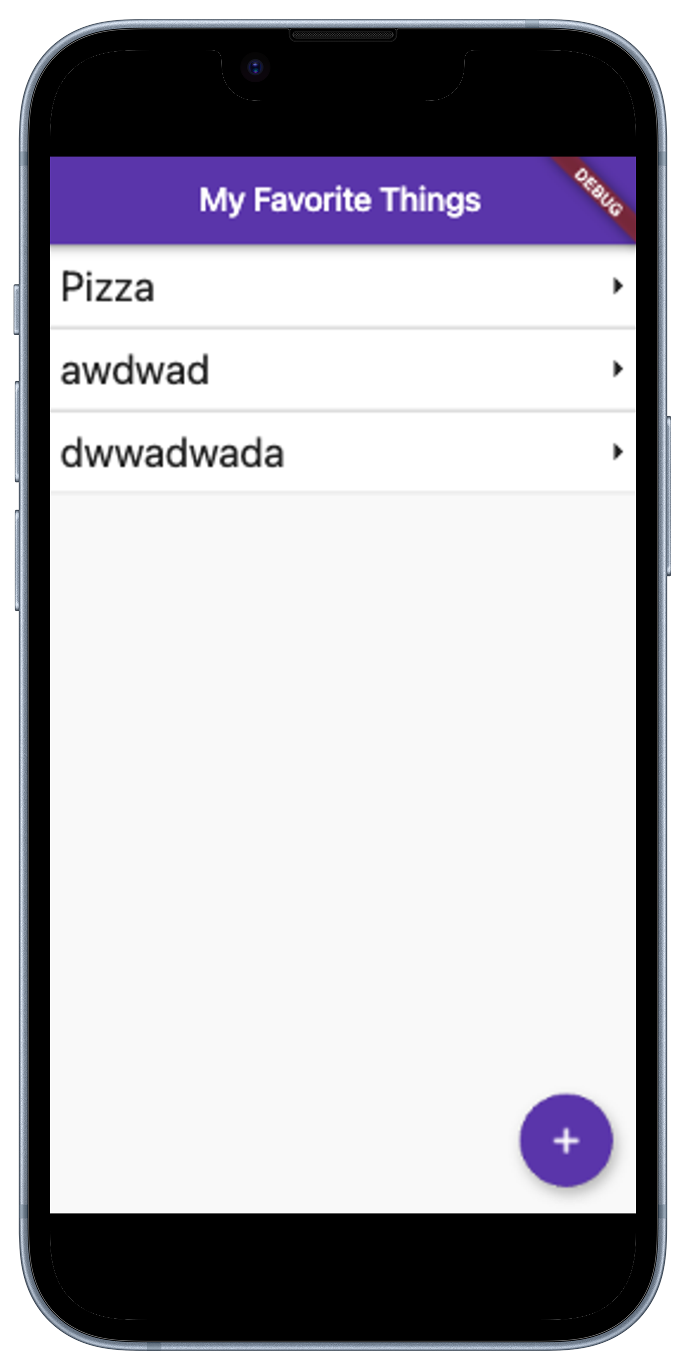
INTERACTIVE SESSION
Let us build any app you want
Work on any app idea you want for the next 30 minutes.
Start from scratch or build up onto our example project https://github.com/sebivenlo/ESD-2023-Flutter/tree/main/assignment
Get use of the default Flutter widgets: https://docs.flutter.dev/ui/widgets
Don't hesitate to ask us if you have any questions!

Slide 42
CONCLUSION
Summary
Flutter compared to other Languages
Basics
Widgets
Layouts & UI
Advanced
Plugins & Packages
State Management

Slide 43
CONCLUSION
Resources. Where to learn more?
Official Websites & Docs
YouTube: Official Flutter Channel
YouTube: Fireship Flutter Playlist (22 videos)

Slide 44

THANKS FOR PARTICIPATING

Slide 45
Sources
Not ChatGPT.
Dart and Flutter Tutorial: marketsplash.com/tutorials/dart/dart-flutter
What's Flutter? - FreeCodeCamp: freecodecamp.org/news/https-medium-com-rahman-sameeha-whats-flutter
Flutter Layout Widgets: docs.flutter.dev/ui/widgets/layout
Frameworks for Cross-Platform Mobile App Development: apptunix.com/blog/frameworks-cross-platform-mobile-app-development
React Native Getting Started: reactnative.dev/docs/getting-started
Xamarin Documentation: learn.microsoft.com/en-us/xamarin
Using Packages in Flutter: docs.flutter.dev/packages-and-plugins/using-packages
Flutter Package Repository - pub.dev: pub.dev
Flutter for Web Development: miquido.com/blog/flutter-for-web-development
Flutter YouTube Tutorial: youtube.com/watch?v=3tm-R7ymwhc
State Management in Flutter: docs.flutter.dev/data-and-backend/state-mgmt/intro
Redux GitHub Discussion: github.com/reduxjs/redux/issues/1287#issuecomment-175351978Issue
Xamarin vs Flutter vs React Native - The Mobile Reality: themobilereality.com/blog/xamarin-vs-flutter-vs-react-native
Xamarin, Flutter, and React Native Comparison - Promatics: promatics.medium.com/heres-who-would-win-if-xamarin-flutter-and-react-native-fight-out-in-2021-8fa6e22fdfbb

